Slide 1
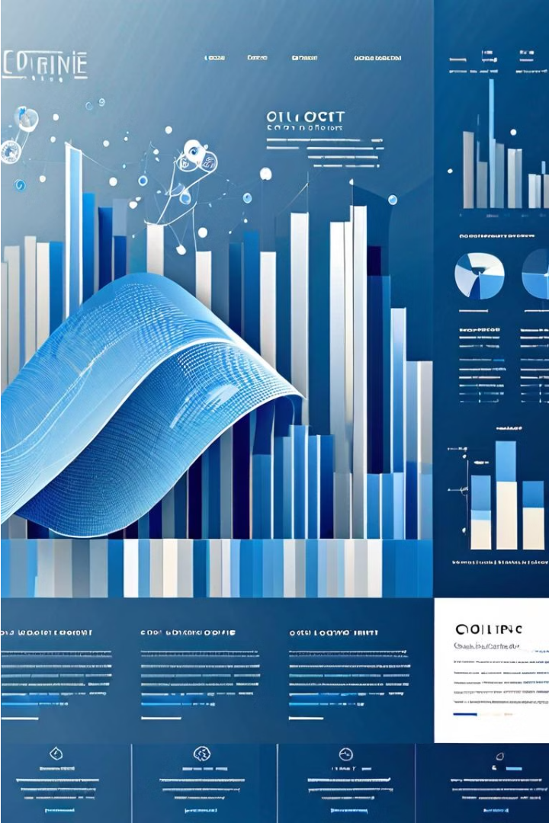
DAV -PROJECT:-
E-commerce Website Sales Analysis
Explore the powerful insights that can be unlocked through data analysis and visualization of e-commerce sales data. Uncover trends, patterns, and opportunities to drive growth and revenue for your online business.

Slide 2
Introduction
E-commerce website sales analysis leverages visualization tools like Tableau or Power BI to interpret data effectively. These tools transform raw sales data into intuitive charts and graphs, aiding in identifying trends, customer behavior patterns, and areas for improvement, ultimately optimizing business strategies and enhancing profitability.

Slide 3

Abstract
This presentation offers a comprehensive analysis of e-commerce sales data, uncovering powerful insights to drive business growth. Through advanced data visualization techniques and exploratory data analysis, we will identify key trends, patterns, and opportunities to optimize your online sales strategy. The findings will inform predictive modeling and data-driven recommendations to propel your e-commerce success.

Slide 4
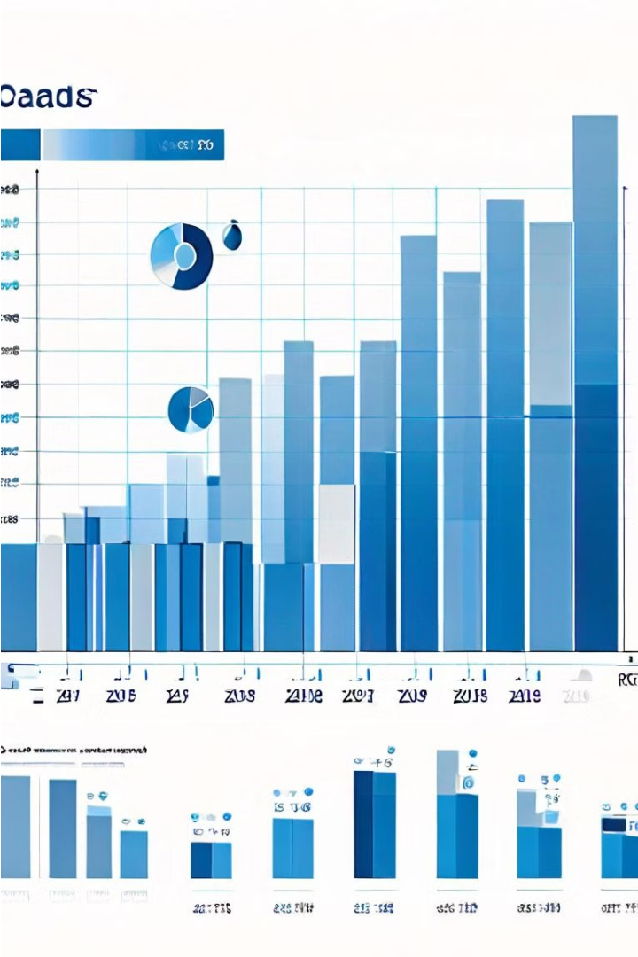
Data Collection and Preprocessing
Gather and cleanse your e-commerce sales data to unlock its full potential. Consolidate disparate data sources, handle missing values, and transform the raw data into a format optimized for analysis and visualization.
Leverage advanced data preprocessing techniques to enhance data quality, identify outliers, and ensure your insights are grounded in reliable, high-fidelity information.

Slide 5

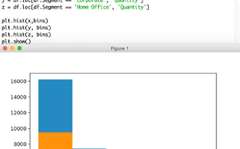
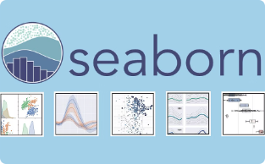

Data Analysis Tools in Python
Pandas
Matplotlib
Seaborn
Scikit-learn
A powerful data manipulation and analysis library, enabling efficient handling of structured (tabular, multidimensional, potentially heterogeneous) and time series data.
A comprehensive library for creating static, animated, and interactive visualizations in Python, providing a wide range of plot types and customization options.
A high-level data visualization library built on top of Matplotlib, offering a more concise and aesthetically pleasing approach to creating statistical graphics.
A machine learning library that provides a wide range of efficient tools for model fitting, data preprocessing, model selection, and evaluation, enabling robust predictive analytics.

Slide 6

Data Visualization Techniques
Unlock the power of visual storytelling to communicate your e-commerce sales insights. Leverage a diverse arsenal of data visualization tools, from intuitive charts and graphs to dynamic dashboards and interactive infographics.
Strategically select visualizations that amplify key trends, patterns, and relationships within your sales data, empowering stakeholders to quickly grasp the underlying story and make informed, data-driven decisions.

Slide 7
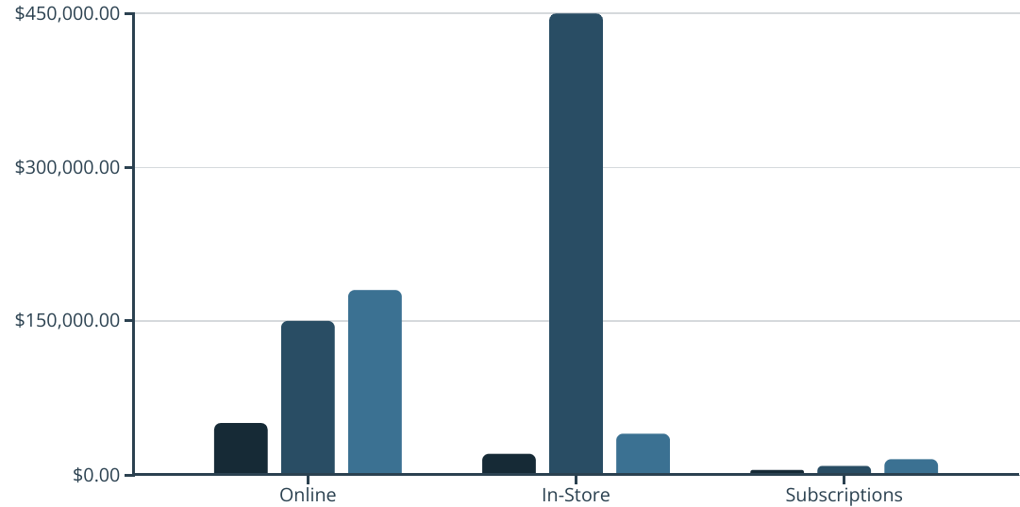
Exploratory Data Analysis
Dive deep into your e-commerce sales data through rigorous exploratory analysis. Uncover hidden patterns, trends, and relationships that can inform strategic decision-making and drive business growth.
Q1
Q2
Q3
The bar chart reveals significant fluctuations in sales across different channels, with in-store sales peaking in Q2 but then dropping sharply in Q3. This suggests the need to further investigate the underlying drivers of these trends.

Slide 8

Trend and Pattern Identification
Sales Trends
Product Performance
Analyze sales data over time to identify seasonal patterns, growth trajectories, and anomalies that could indicate new opportunities or areas for optimization.
Dive into product-level sales data to detect top sellers, understand product affinities, and identify underperforming items that may need further attention.
1
2
3
Customer Behavior
Uncover insights about customer preferences, browsing habits, and purchasing triggers by studying clickstream data and user interactions on the e-commerce website.

Slide 9
Predictive Modeling
Forecasting Sales Trends
Customer Segmentation
Optimizing Inventory
Churn Prediction
Identify customers at risk of churning and implement targeted retention campaigns. Use predictive analytics to understand the key factors driving customer attrition.
Apply machine learning algorithms to predict future sales based on historical data. Identify patterns and drivers that influence customer demand.
Cluster customers into distinct groups based on their browsing behavior, purchase history, and other demographic attributes. Tailor marketing strategies for each segment.
Develop predictive models to forecast inventory needs and minimize stockouts. Anticipate demand fluctuations and proactively adjust replenishment strategies.

Slide 10
Insights and Recommendations
1
Optimize Product Mix
2
Enhance Customer Experience
Identify top-selling products and capitalize on customer demand. Streamline the product catalog and prioritize inventory of high-performing items.
Improve website navigation, search functionality, and personalized recommendations to create a seamless and engaging shopping experience.
3
Leverage Data-Driven Marketing
4
Improve Inventory Management
Utilize customer segmentation insights to craft targeted marketing campaigns and promotional strategies that resonate with different buyer personas.
Leverage predictive models to forecast demand and optimize inventory levels, reducing stockouts and maintaining a healthy balance of supply and demand.

Slide 11

Conclusion
In conclusion, this comprehensive e-commerce sales analysis has uncovered invaluable insights to propel your online business forward. By leveraging advanced data visualization techniques and predictive modeling, we have identified key trends, customer behaviors, and optimization opportunities that can drive sustainable growth.

Slide 12

Thank You:-
GROUP MRMBERS:-
Y.Rohit-160122737136
M.Dev-160122737114
K.Shivanand-160122737110

